Slide 1
Feeling Lucky?
Vu Do, Reynoldo Slater, Natalia Elmowafi, Jack Thomeer
[10/5/2020]

Slide 2
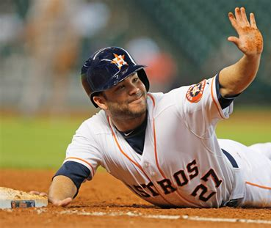

Key Findings
By using different types of Machine Learning Models, we were able to correctly predict Astros’s Wins or Losses in the upcoming games (were not able to predict the score though).
In a small sample size, 2 out of 4 Astros games were accurately predicted so far
historical data from 2013-2019 of the pitching metrics, hitting metrics and distance traveled (for the opposing team and Astros) were used for testing/training the model
5 different ML models were used; however the most accurate prediction was made by Logistic Regression model.

Slide 3
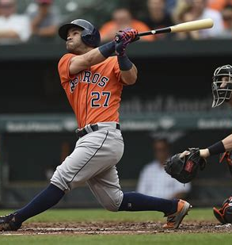
Data Acquisition / Cleanse / Preparation
Data Sources
www.Baseball-Reference.com www.baseballcube.com
Data Preparation
Uploaded yearly csv files for pitching, hitting and schedule data
Combined all data into one usable Dataframe
Created functions in order to match starting pitching data, team hitting data and distance data to match the schedule data.
Utilized a library called uszipcode to define the distance between stadiums using latitude/longitude using haversine_distance function

Slide 4
Hypothesis
Our assumptions were that following values would have the greatest effect on the outcome of the model:
SP ERA, SP FIP, Team Runs/Game, Team Batting Average, Team OBP
However, Random Forest importance values results were a bit different.

Slide 5
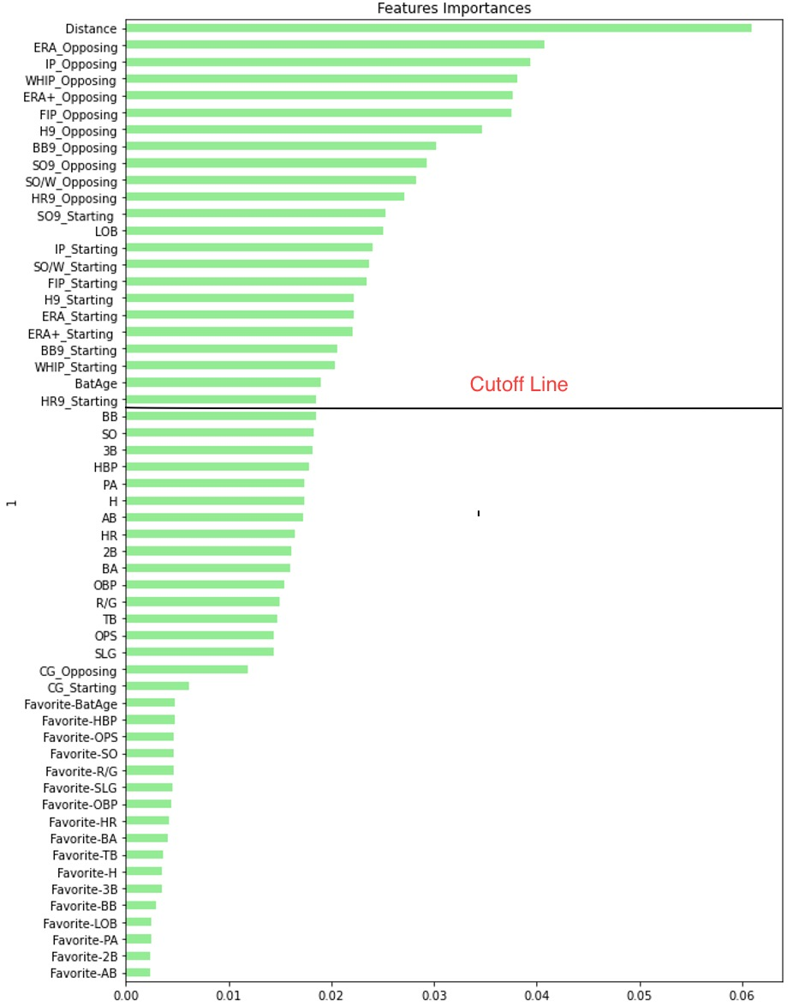
Distance - # of miles between stadiums
Innings – unit of play, 9 innings are played every game (two frames per inning in which team must record 3 outs) (rounds)
ERA – Earned Run Average (per 9 innings pitched)
IP – innings pitched
WHIP – Walks/Hits per inning
ERA+ - ERA adjusted for ballpark
FIP – fielding Independent Pitching
BB9 – bases on balls per 9 innings
SO9 – strikeouts per 9 innings
HR9 – homeruns per 9 innings
LOB – batters left on base
WHIP – walks and hits given per inning
BateAge – average age of batters on a team

Slide 6

Models, Evaluation & Performance
We used following ML models in order to predict games outcomes:
Random Forest, Decision Tree, XCBG, K-Neighbors, Logistic Regression

Slide 7
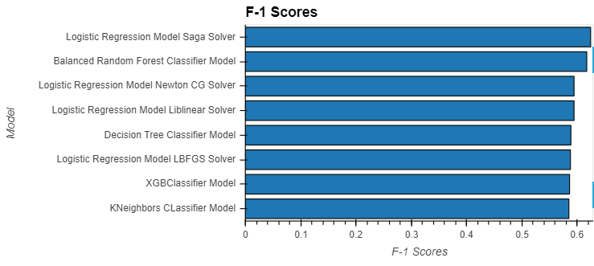
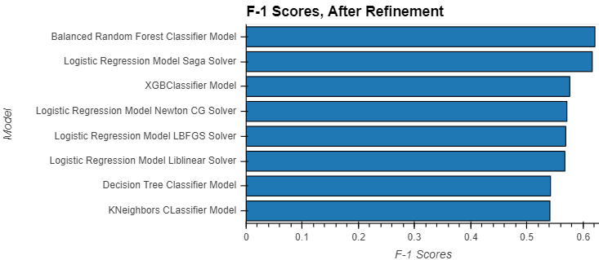

Slide 8
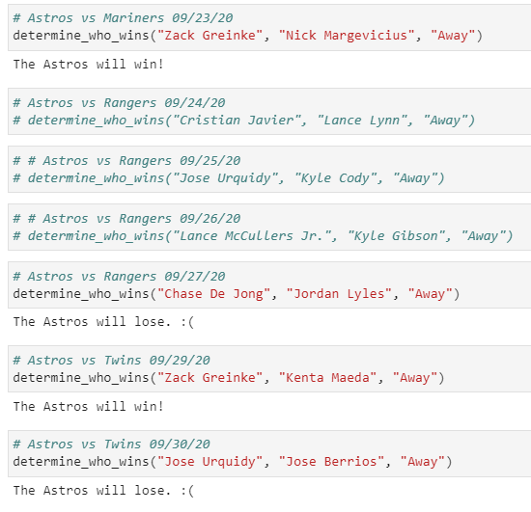

Slide 9

